Slide 1

Is Tesla Equity Outperforming the Market for the next 5, 10 and 15 Years?

Slide 2
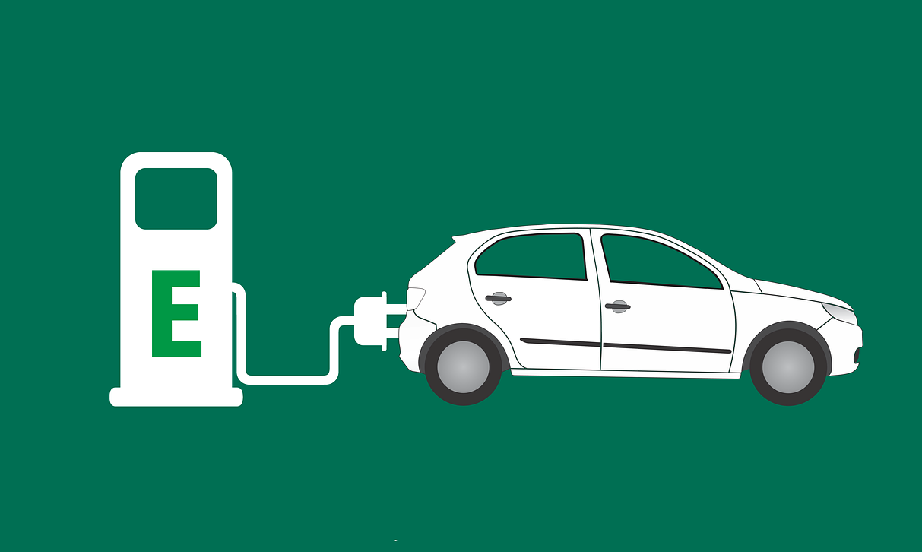
Team members:
Minh Tran
Syed Naqvi
Rodrigo Guazzelli
Hsuan Liu
Abdullah Mamun

Slide 3
Data needed:
Growing Industry
Market size, CAGR of EV market (Global and US market),
Yearly sales of EV vs gas vehicle – to show the uptrend of EV sales?
EV sales portion vs New car sales
Diversification Effect:
TSLA revenue breakdown by region, customer breakdown by region (use the map)
Other regional data ?
Social Impact:
CO2, environment, death rate of TSLA
Financial:
TSLA Financials: EBITDA, capex, profitability, risk of the investment
TSLA valuation- comps model
Stock Price Performance and Simulation:
Historical stock price of TSLA and S&P500 and TSLA’s main competitor from 2015-2020
Monte Carlo simulation for the next 5, 10 and 20 years

Slide 4
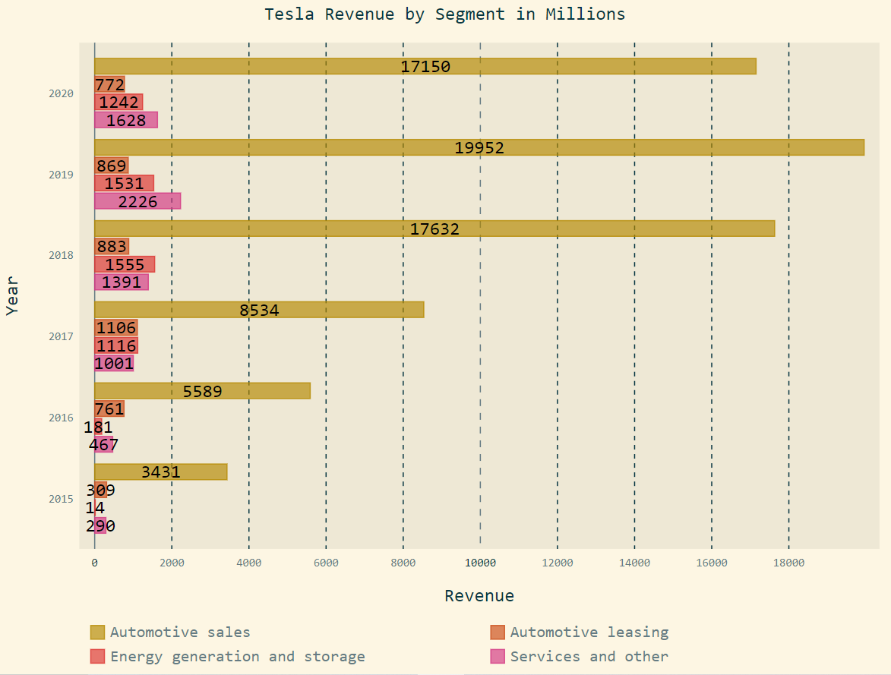
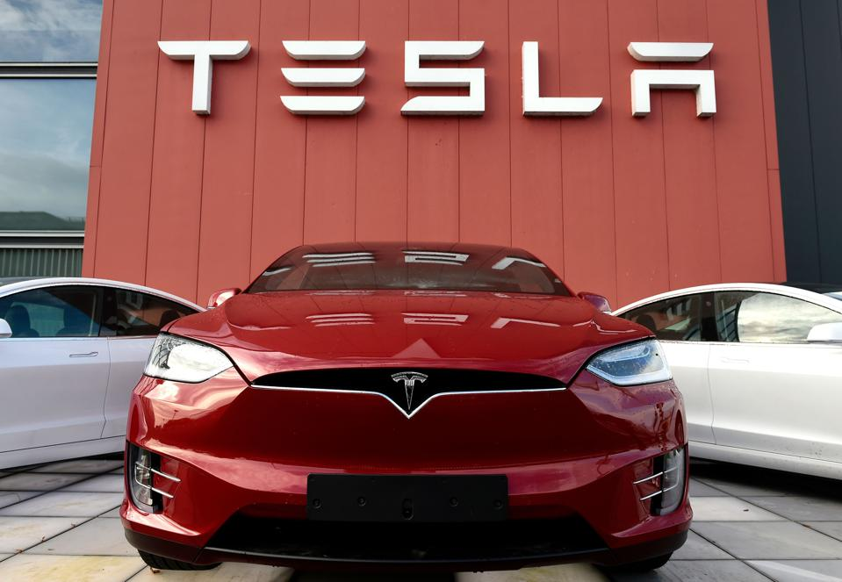
TSLA-Revenue Breakdown
Revenue Breakdown by Segment
Tesla Possible Future Incomes
In-house car insurance
Robo-taxi
Ride-hailing Vehicles and Services
FSD & Software as a service
Industry batteries
Computer chips for FSD
4

Slide 5
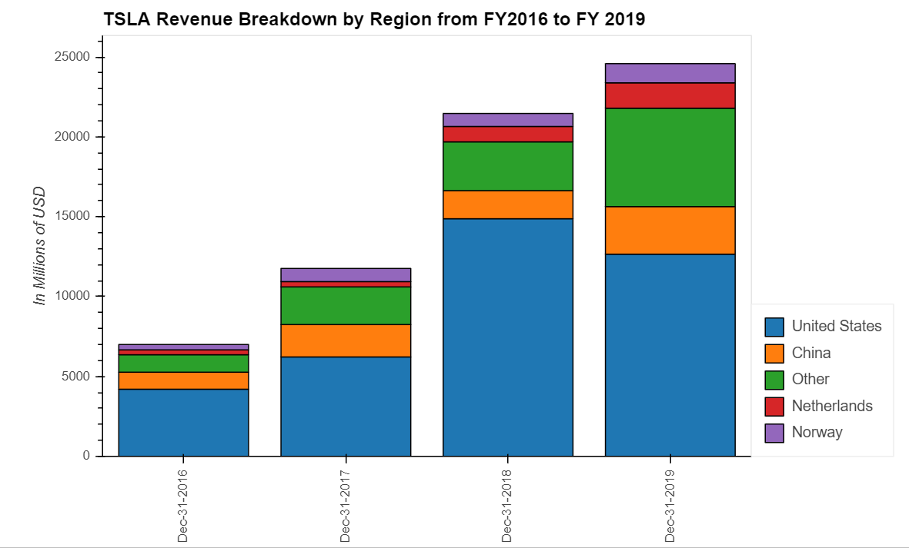
TSLA-Revenue Breakdown
Revenue Breakdown by Region
XXXX
In-house car insurance
Robo-taxi
Ride-hailing Vehicles and Services
FSD & Software as a service
Industry batteries
Computer chips for FSD
5
Source ：FactSet, Equity Research Report, FS

Slide 6
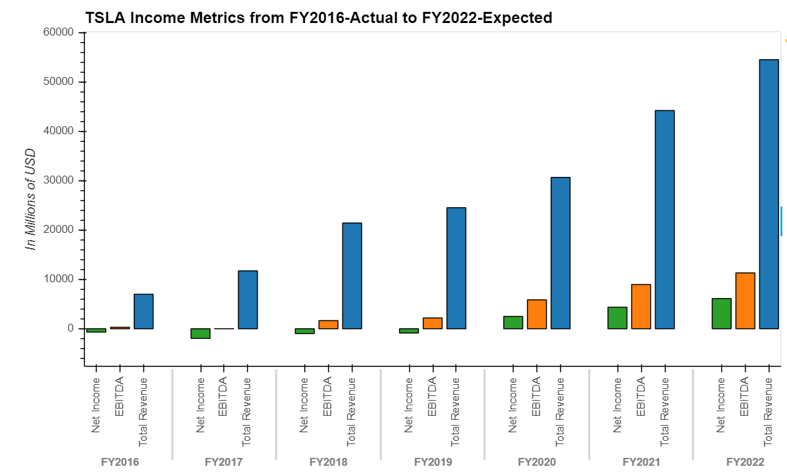
TSLA-Financial Analysis
Income Metrics- Net Income, EBITDA, Revenue
Profitability
Revenue CAGR 36.89% from FY2016 to 2019
EBITDA CAGR 64.12% from FY2016 to 2019
Net Income has turned positive in FY2020
Capex growth trend with cumulative 12 months YoY of 94.62% to $ 2,423 as of Sep 30 2020
Average Capex from FY2016 to 2020 LTM is $2237.4 M
Revenue CAGR 36.89%
EBITDA CAGR 64.12%
6
Source ：FactSet, Equity Research Report, FS. Note 1, adjusted EBITDA = EBITDA excludes share based payments
Notes:
(1,634.9) (1,440.5) (4,081.0) (2,319.0) (1,432.0)

Slide 7
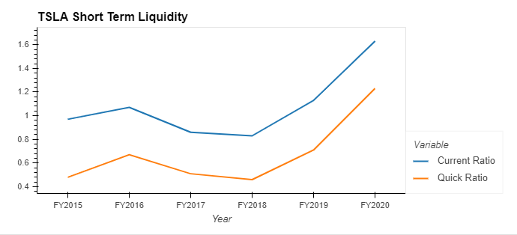
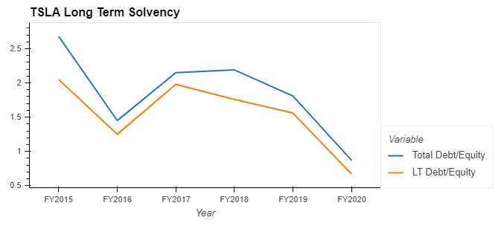
TSLA-Financial Analysis
Short-term Liquidity Analysis
Long-term Solvency
Current and quick ratio trend up, indicating TSLA’s ability to meet short-term liabilities with short-term assets
The higher the ratio, the more debt a company has on its books, meaning the likelihood of default is higher.
7
Source ：FactSet, FS

Slide 8
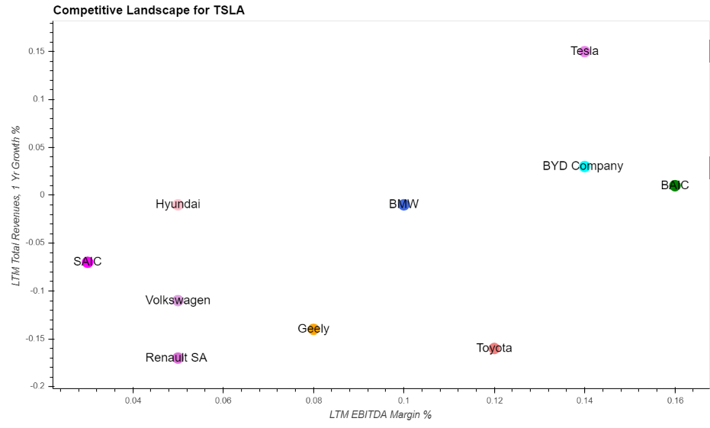
TSLA- Competitive Landscape
First Tier Company - TSLA
Selected Competitors
Toyota
BMW
BAIC
Volkswagen
BYD Company
SAIC
Renault SA
Hyundai
Geely
Tesla
Highlights
TSLA has EBITDA margin around 14% and revenue YoY of 15%, serving as an industry leader
Compared to industry median of 9% EBITDA Margin and -4% 1-year Revenues Growth, TSLA becomes competitive and first tier candidate
8
Notes:
https://insideevs.com/news/396714/world-top-10-plugin-automotive-groups-2019/
Toyota
BMW
BAIC
Volkswagen
BYD Company
SAIC
Renault SA
Hyundai
Geely
Tesla

Slide 9
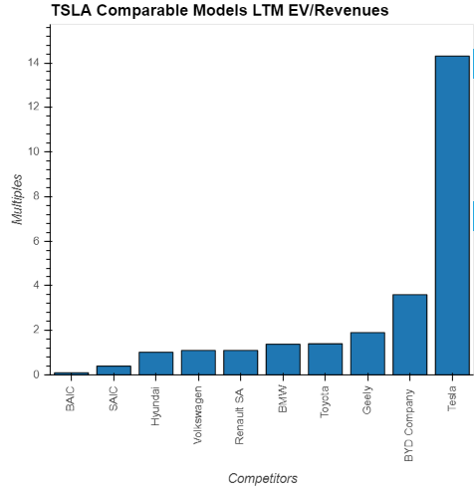
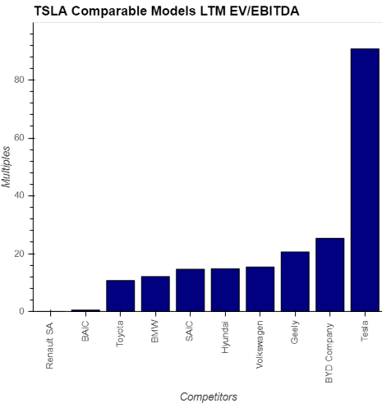
TSLA-Comparable Models
Valuation Highlights - EV/Revenues LTM is 14.3x
Valuation Highlights - EV/EBITDA LTM is 90.8x
Industry Median:1.24x
Industry Median:14.70x
9
Source ：FactSet, Equity Research Report, FS
Notes:
TEV/Total Revenues LTM – Latest 14.3
TEV/EBITDA LTM – Latest 90.8
Industry 50th percentile
TEV/Total Revenues LTM - Latest 1.2 TEV/EBITDA LTM - Latest 16.6

Slide 10
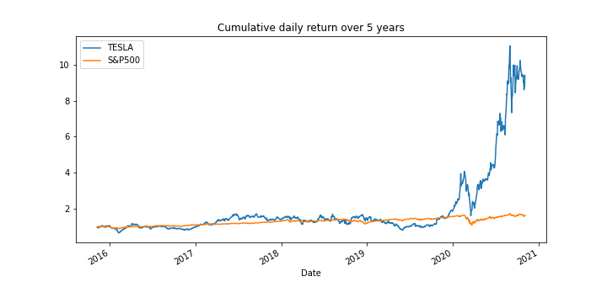
TSLA-Historical price Analysis for the last 5 years
TSLA vs S&P500
Source ：Alpaca trade API / Yahoo Finance

Slide 11
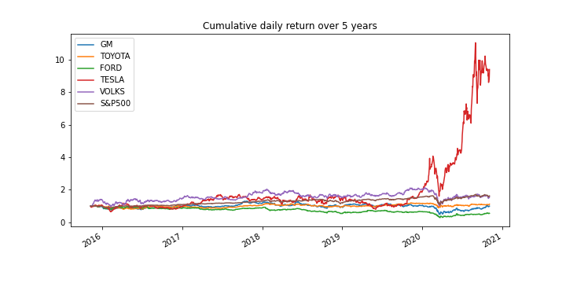
TSLA-Historical price Analysis for the last 5 years
TSLA vs main competitor
Source ：Alpaca trade API / Yahoo Finance

Slide 12
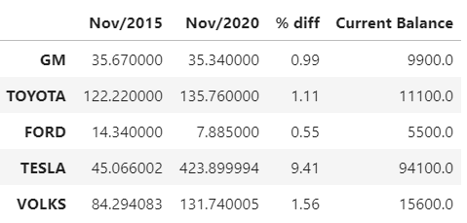
TSLA-Historical price Analysis for the last 5 years
Stock price
If you had invested $10,000 in TESLA stock 5 years ago your current balance would be $94,100
Source ：Alpaca trade API / Yahoo Finance

Slide 13
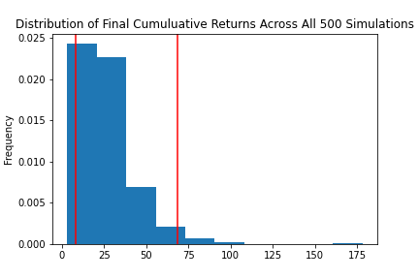
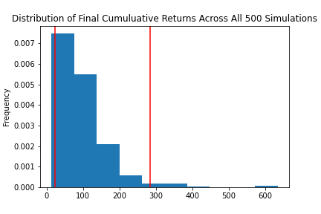
TSLA-Sensitivity Analysis for next 20 years
Monte Carlo Simulation Portfolio Without Tesla
Monte Carlo Simulation Portfolio With Tesla
With an initial investment of $10,000 in your portfolio you have a 95% chance it will be within the range of $82,972.21 and $683,666.61 over the next 20 years
With an initial investment of $10,000 in your portfolio you have a 95% chance it will be within in the range of $226,781.95 and $2,835,449.51 over the next 20 years
Portfolio = Apple Inc. , Alphabet Inc. , Johnson & Johnson , Berkshire Hathaway Inc.
Source ：Alpaca trade API / Yahoo Finance

